Slide 1
Technical Software
Product Management
Prof. Dr. Dirk Riehle
Friedrich-Alexander University Erlangen-Nürnberg
PROD C03
Licensed under CC BY 4.0 International
Notes:
It is Friedrich-Alexander University Erlangen-Nürnberg – FAU, in short.
Corporate identity wants us to say “Friedrich-Alexander University”.

Slide 2
Technical Product Management (Recap)
Key processes
  Detailed product planning
  Detailed release planning
  Feature validation
Example practices
  Feature specification
  Feature prioritization
  PRD maintenance
Key artifacts
  Product Requirements Document (PRD)

Slide 3
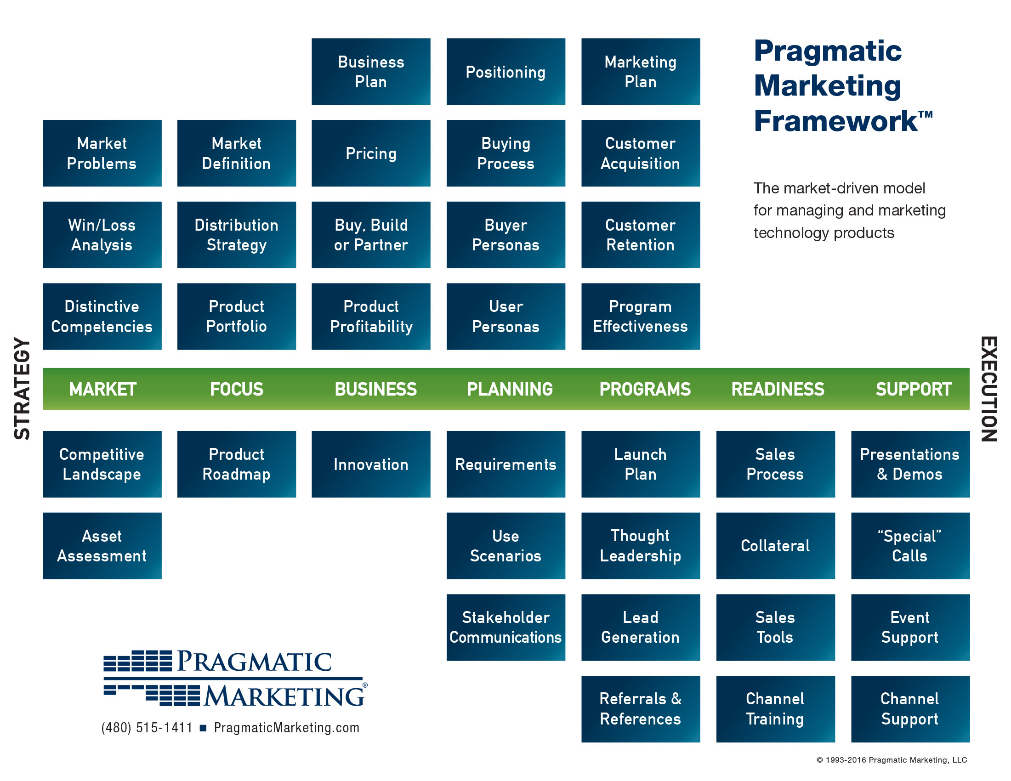
Strategic
Technical

Slide 4
Product Requirements Document (PRD)
Functional Specification
Technical Specification
Whole Product Package

Slide 5
Functional Specification (PRD 1 / 3)
Types of requirements
Structure of document
Individual requirements
  Feature definition
  Feature prioritization
  User experience design

Slide 6
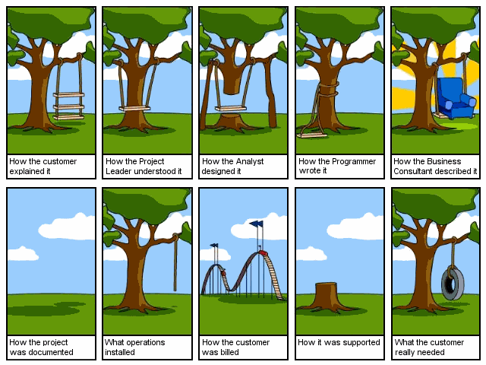

Slide 7
Cartoon Lessons
Understanding project requirements is hard
  Understanding market requirements is even harder!
Innovative products cannot be predicted easily
  Certainly customers don’t always know what they want
Product management orchestrates many stakeholders

Slide 8
Agile / Scrum Product Planning
...
...
Release 1.3
New functionality
Release 2.0
New architecture
Release 2.1
Major bug fixes
2014-04-01
2014-10-01
2015-04-01
time
...
Rel. m-1
Rel. m
Rel. m+1
...
6-12 months
6-12 months
6-12 months
time
Sprint n-1
Sprint n
Sprint n+1
...
...
P
E
3R
P
E
3R
P
E
3R
1-4 weeks
1-4 weeks
1-4 weeks
time

Slide 9
Release Plan
Functional specification of a release
  Consists of all features considered part of that release
Agile / Scrum release plan
  Structures the release into sprints by theme and purpose
  Is a planning and communication tool, not a strict plan
  Evolving: Is adapted in reaction to changes in team and environment

Slide 10
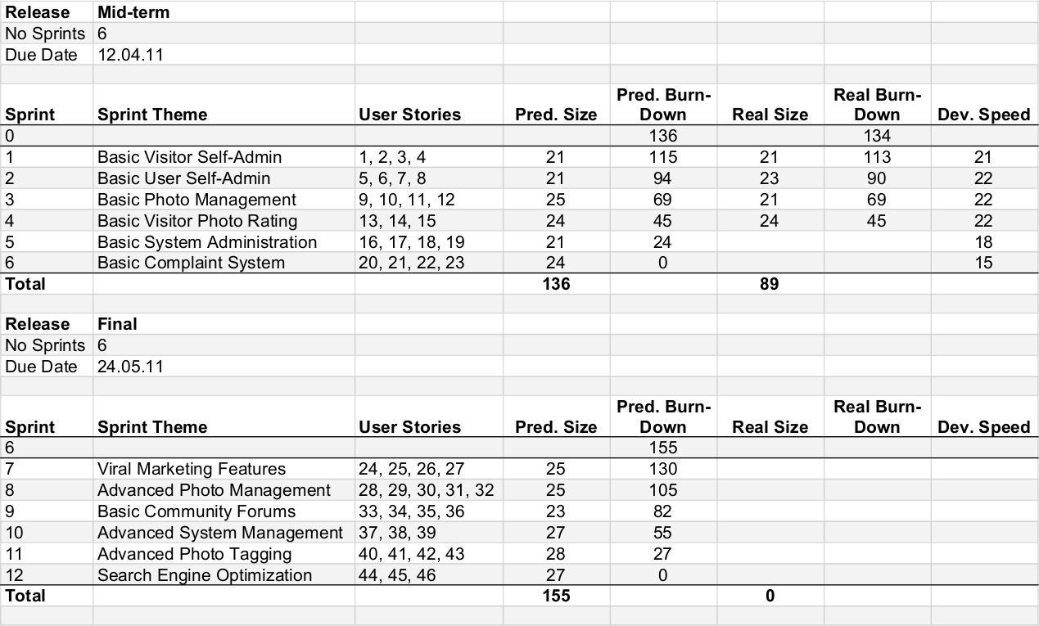
Example Release Plan

Slide 11
Agile / Scrum Product Backlog (Functional Specification)
Product backlog
  Is a prioritized list of features for upcoming relaase
  Scrum’s PRD and the product owner's primary work artifact
  Does not contain any task descriptions or assignments
  Is a living document (rather than static) and keeps evolving

Slide 12
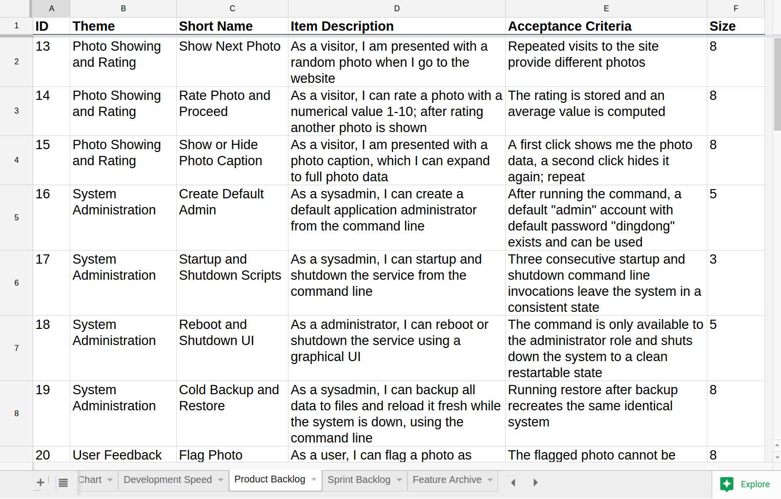
Example Product Backlog

Slide 13
Domain Glossary
Domain glossary
  A list of concepts and their definition from the product being developed
  The missing link between the vision and the product backlog
  Is a “poor man’s approach” to a domain model
Glossary term
  Have a clear fully-defined name for glossary entry
  Have a crisp “is a” definition, followed by secondary properties
  Definitions are short; rarely longer than a paragraph
  Glossary entries are human readable, not machine-processable
More entries
  Synonyms are listed as their own entries
  Shorthands point to the full name (not the other way around)

Slide 14
Example Domain Glossary
Term | Definition
Individual Photo Rating | A photo rating by a single user of a particular photo at a given point in time.
Overall Photo Rating | A photo rating that represents the community's ranking of the photo in question. Over time, a photo accumulates a large number of individual ratings …
Photo | A photo is a flower photo that has been uploaded (and is owned) by a system user. A photo has a status that determines its accessibility.
Photo Rating | A numerical value 1..10 that rates a given photo.
Photo Sharing Policy | Flowers has a photo sharing policy. The policy determines what an acceptable photo is. Photos are unacceptable if they are unrelated to the Flower's purpose (e.g. ...)

Slide 15
Connecting Product Vision with Backlog Through Glossary
Product
Vision
Product
Glossary
Product
Backlog

Slide 16
Types of Product Backlog Entries
Feature
  A feature is a distinguishing characteristic of a software item (for example, performance, portability, or functionality) [IEEE 829]
Epic
  An epic is a large feature awaiting break-down into smaller features; in a product backlog, it acts as a placeholder for these smaller features
(User) story
  A user story is a feature presented using a the user-story-pattern that is small enough to be implemented in a sprint
Refactoring
Bug report

Slide 17
Model of Product Backlog Items
Theme
Backlog Item
Feature
Epic
User Story
Bug Report
Refactoring

Slide 18
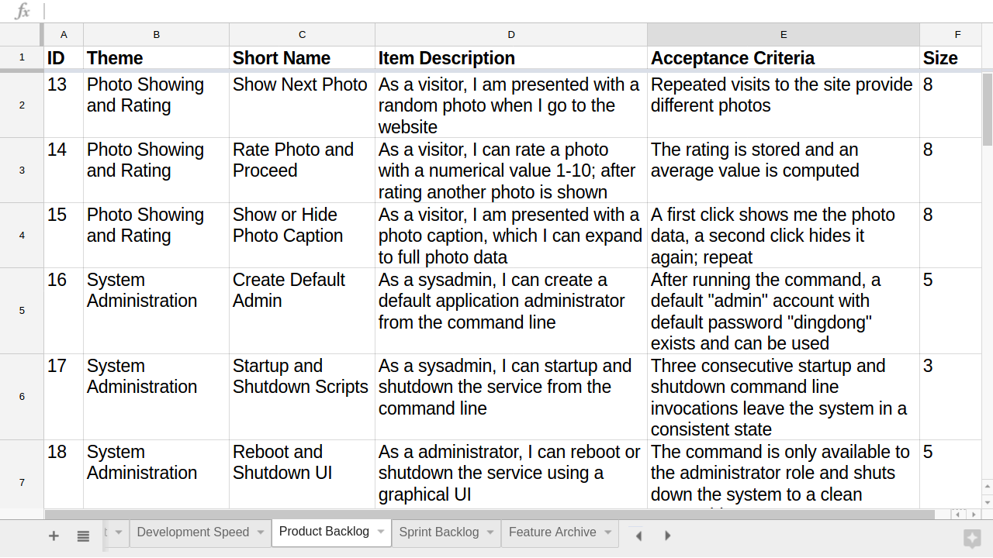
Example Product Backlog Item

Slide 19
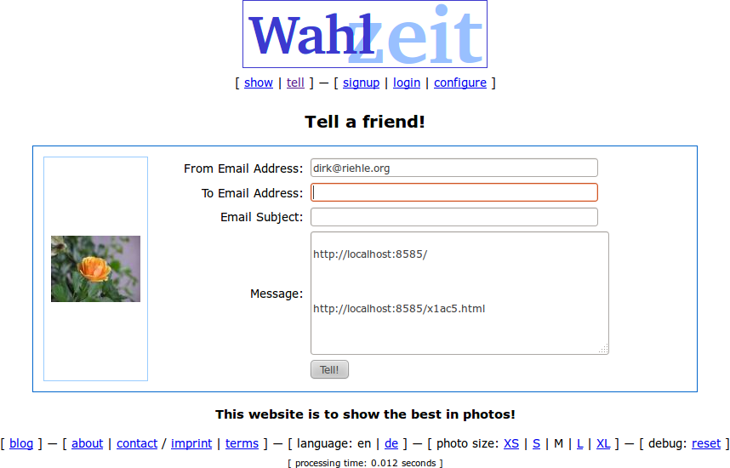
Flowers / Tell-a-Friend Implemented

Slide 20
Agile Sentence Template (User Story)
As a
<persona>
I need
<function>
so that
<value>

Slide 21
Classic Requirements Specification Sentence Template
As a
<expr>
must
offer <actor> the opportunity to
As a
As a
If
When
<event>
should
<system>
be able to.
<object>
As long as
<duration>
will
.
<activity>

Slide 22
Acceptance Criterion
An acceptance criterion for a backlog entry
  Is a proposition that must be true
    Before the entry can be accepted (signed-off on)
Acceptance criteria
  A set of criteria that need to be fulfilled

Slide 23
Feature Priority Categories
Essential / High
Conditional / Medium
Optional / Low

Slide 24
Prioritizing Features by Value and Risk
risk
high
realize
never
x
1
realize
first
value
value
low
3
realize
second
realize
last
2
high
risk
low

Slide 25
Classifying Features by Kano Model
customer satis-faction
high
exciters and
delighters
degree of feature
implementation
not at all
fully
must-have
linear
low

Slide 26
Technical Specification (PRD 2 / 3)
Definition of platform, language, tools
Required services and capabilities

Slide 27
Definition of Done
Definition of Done (DoD)
  An auditable check-list of results
  Built from value-adding activities
  That everyone previously agreed to
  It is about the non-functional aspects of work

Slide 28
Example DoD for Product Release
Project builds, deploys, and tests successfully
Component test coverage is 70% or higher
Database upgrade in test environment succeeded
Software documentation passes external review
User manual passes external review

Slide 29
Example DoD for Single Feature
Unit tests for feature have been written and are passing
Code review has been completed
Feature branch has been tagged and merged
Project builds, deploys, and tests successfully
Feature was demoed and accepted by product owner

Slide 30
Definition of Done vs. Acceptance Criteria
DoD (Feature)
  Specific to a particular type of artifact
  The same for all instances of that type
Acceptance Criteria
  Specific to a particular artifact

Slide 31
The Whole Package (PRD 3 / 3)
Product package and collateral
Ancillary services

Slide 32
Review / Summary of Session
The Product Requirements Document (PRD)
  Functional Specification
  Technical Specification
  Whole Product Package

Slide 33
Thank you! Questions?
dirk.riehle@fau.de – http://osr.cs.fau.de
dirk@riehle.org – http://dirkriehle.com – @dirkriehle
DR

Slide 34
Credits and License
Original version
  © 2012-2018 Dirk Riehle, some rights reserved
  Licensed under Creative Commons Attribution 4.0 International License
Contributions
  ...

